Slide 1
Junhong Li
July 22, 2021
IBM Data Science Capstone
Boston Common Restaurant Recommendation
EDA + Clustering
Pitch 2021

Slide 2

Introduction
Background
The tourism and catering industry positively affects the promotion of a city's economy and visibility. However, due to the COVID-19 pandemic in 2020, it hit the global travel and catering industry hard. As more people are vaccinated, restrictions in countries and regions are gradually opening up. As a result, people began to have the desire to resume travel. As a city with rich culture and history on the east coast of the United States, Boston attracts many tourists every year. Four Season Hotel Boston, located in Boston Common, is the perfect place for many tourists. Four Season Hotel Boston wants to write a new Boston travel guide for its guests, including Boston attractions and dining around the Hotel. For the recommended introduction of scenic spots, you can follow the previous year's guide to do some appropriate content updates; However, due to the impact of the COVID-19 pandemic on the restaurant industry and recent changes in surrounding restaurants, this section needs to be rewritten.

Slide 3
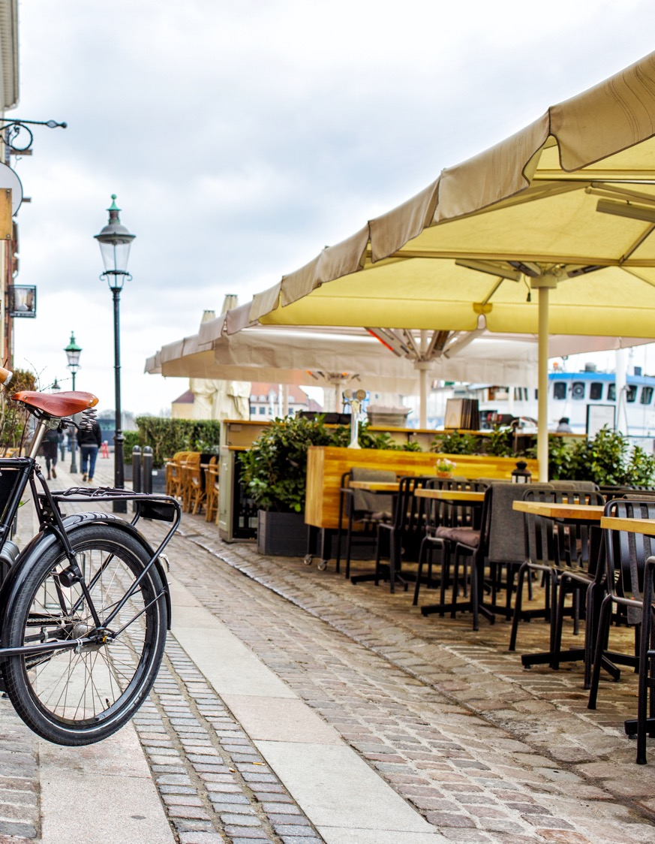
Introduction
Problem
Due to the location of Four Seasons Hotel Boston, there are a large number of restaurants of various types nearby. The Hotel hopes to recommend high-quality restaurants of the overall type to increase tourists' overall satisfaction with the Hotel service while avoiding the presence of low-quality restaurants in the guide to affect the Hotel rating.

Slide 4
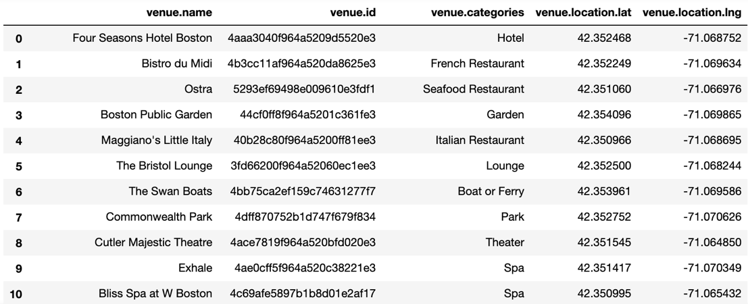
DATA
Data Source
Foursquare API
Data Info
There are 92 records of the original data. Where venue. The name represents the name of the merchant, venue. Venue. Location refers to the geographic coordinates of the location.

Slide 5
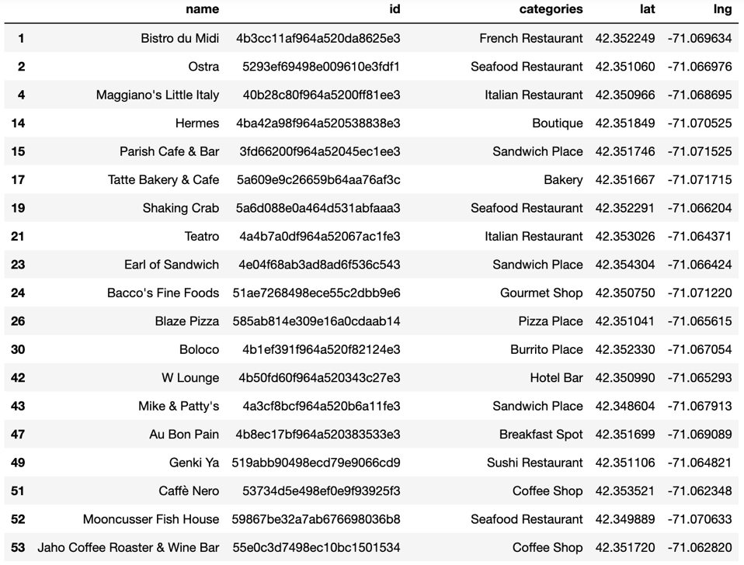
DATA
Data Cleaning
Every column's name contains unnecessary content that needs to be removed. The name of columns with the venue prefix makes it difficult to understand data.
It contains categories other than restaurants, which are not required by the project and need to be dropped.
The original data lacks effective quantitative indicators for restaurant evaluation.

Slide 6

Exploratory data analysis (EDA)

Slide 7
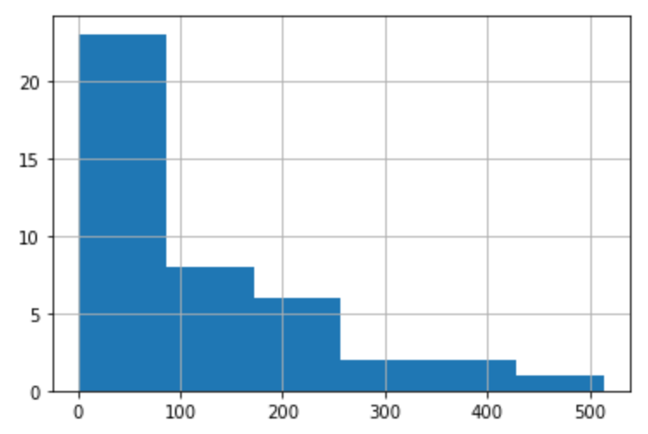
EDA
Data distribution of Total Likes
Max = 513
Min = 1
Median = 62.5
Mean = 113.20
Data distribution of Total Likes

Slide 8

Rating Level
26
62.5
173
First Quartile
Median
Third Quartile
Total likes < 26 Rating level: Poor
Total likes ≥ 26 and < 62.5 Rating level: Below Average
Total likes ≥ 62.5 and < 173 Rating level: Average
Total likes ≥ 173 Rating level: Great

Slide 9
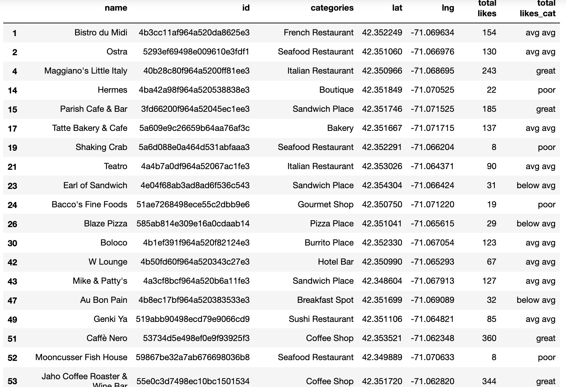

Slide 10
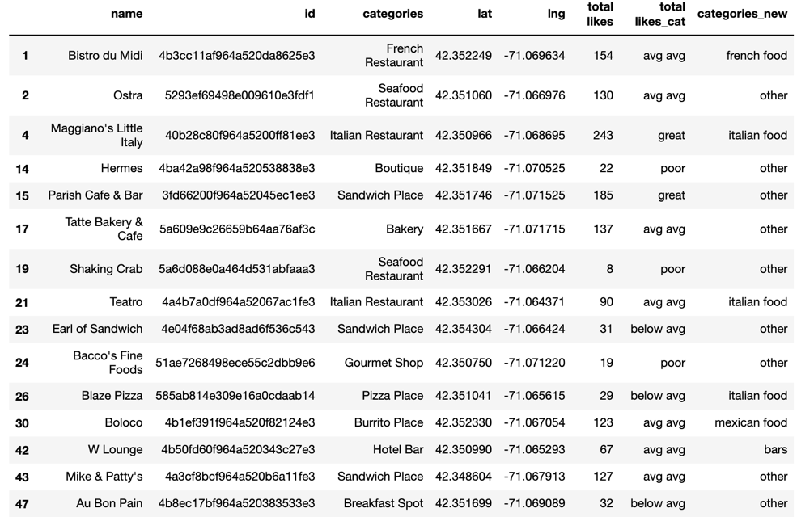
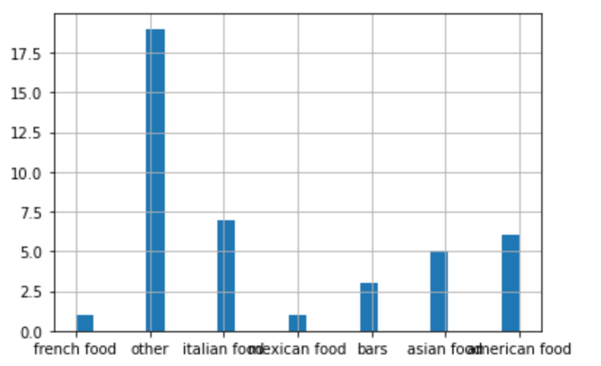
EDA
Restaurant Category
bars = Bar, Dive Bar, Hotel Bar
other = Sandwich Place, Bakery, Boutique, Breakfast Spot,Coffee Shop, Donut Shop, Café, Seafood Restaurant , Gourmet Shop
asian_food = Sushi Restaurant, Hotpot Restaurant, Noodle House, Vegetarian / Vegan Restaurant, Chinese Restaurant
mexican_food = Burrito Place
american_food = Steakhouse, American Restaurant, Restaurant
italian_food = Italian Restaurant, Pizza Place
french_food = French Restaurant

Slide 11
Clustering Modeling

Slide 12
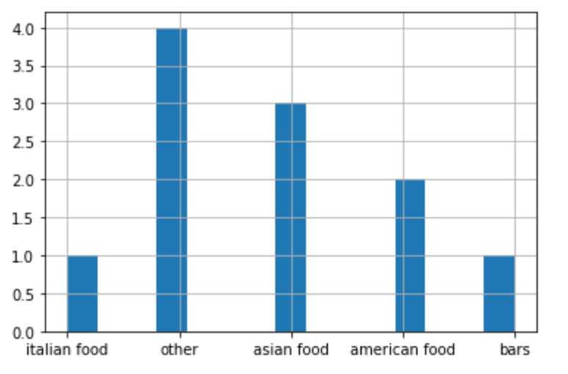
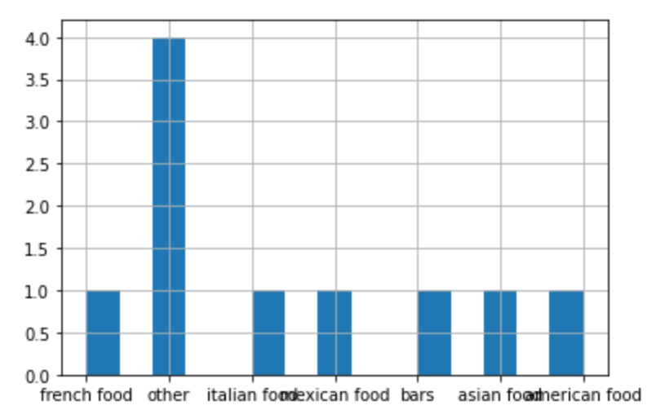
Clustering Modeling
Great Restaurant Categories
Average Restaurant Categories

Slide 13
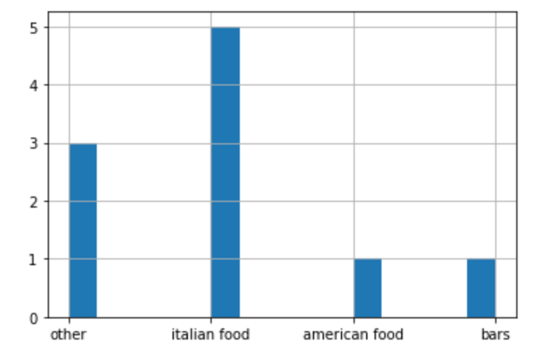
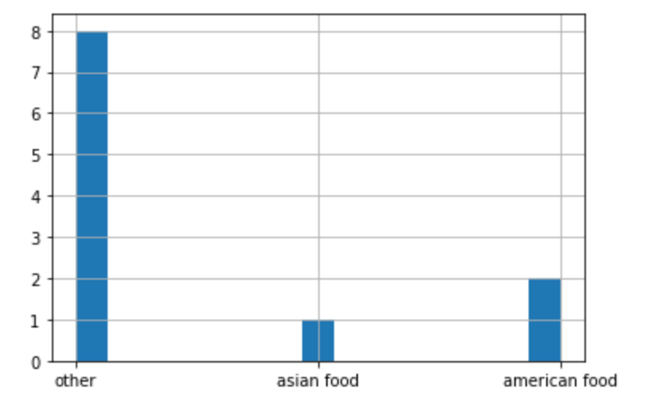
Clustering Modeling
Below Average Restaurant Categories
Poor Restaurant Categories

Slide 14
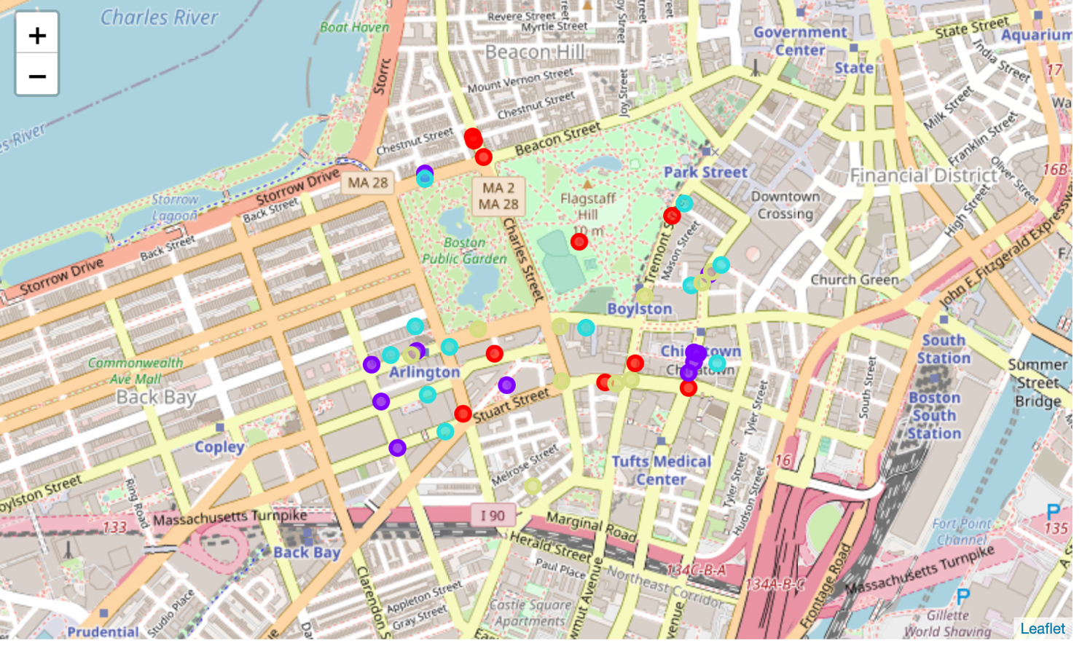
Mapping
Great
Average
Below Average
Poor

Slide 15

A B O U T U S
Conclusion
Of the 42 restaurants, the most popular overall and the highest-rated were those running Asian food. Although many Restaurants are operating Italian food around the hotel, the Overall Score of Italian restaurants is below average.
Suggestions & Insights
Restaurants that serve Asian food receive the highest ratings.
The number of Italian restaurants near the hotel is high, but most score below average.
Hotels can add Asian food to new dishes to improve customer satisfaction and get good commercial returns.

Slide 16
Data Source:
THANK
Foursquare API
YOU
Project Related File links: https://github.com/HotPotBubbleT/IBM-DS-Capstone-Project

